Slide 1

PDR
Alex Toth, Ryan Brown, Ryan Yount, Corinne Smith

Slide 2
Overview
Background
Design Requirements
Selected Concept
Final Concept Changes
Motor Considerations
Product Architecture
Budget

Slide 3
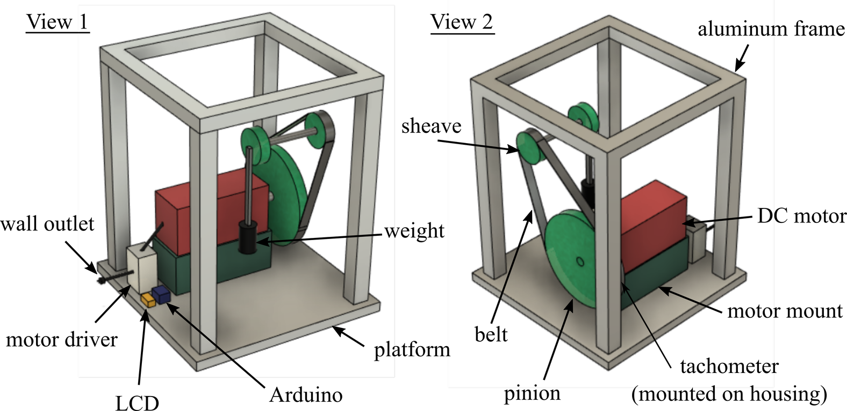
Final concept changes
Motor driver directly used, input analog knob
Arduino now used as a sensor with display screen
Gear ratios changed to large motor gear and small gear attached to linkage
Need a different motor

Slide 4
Budget

Slide 5
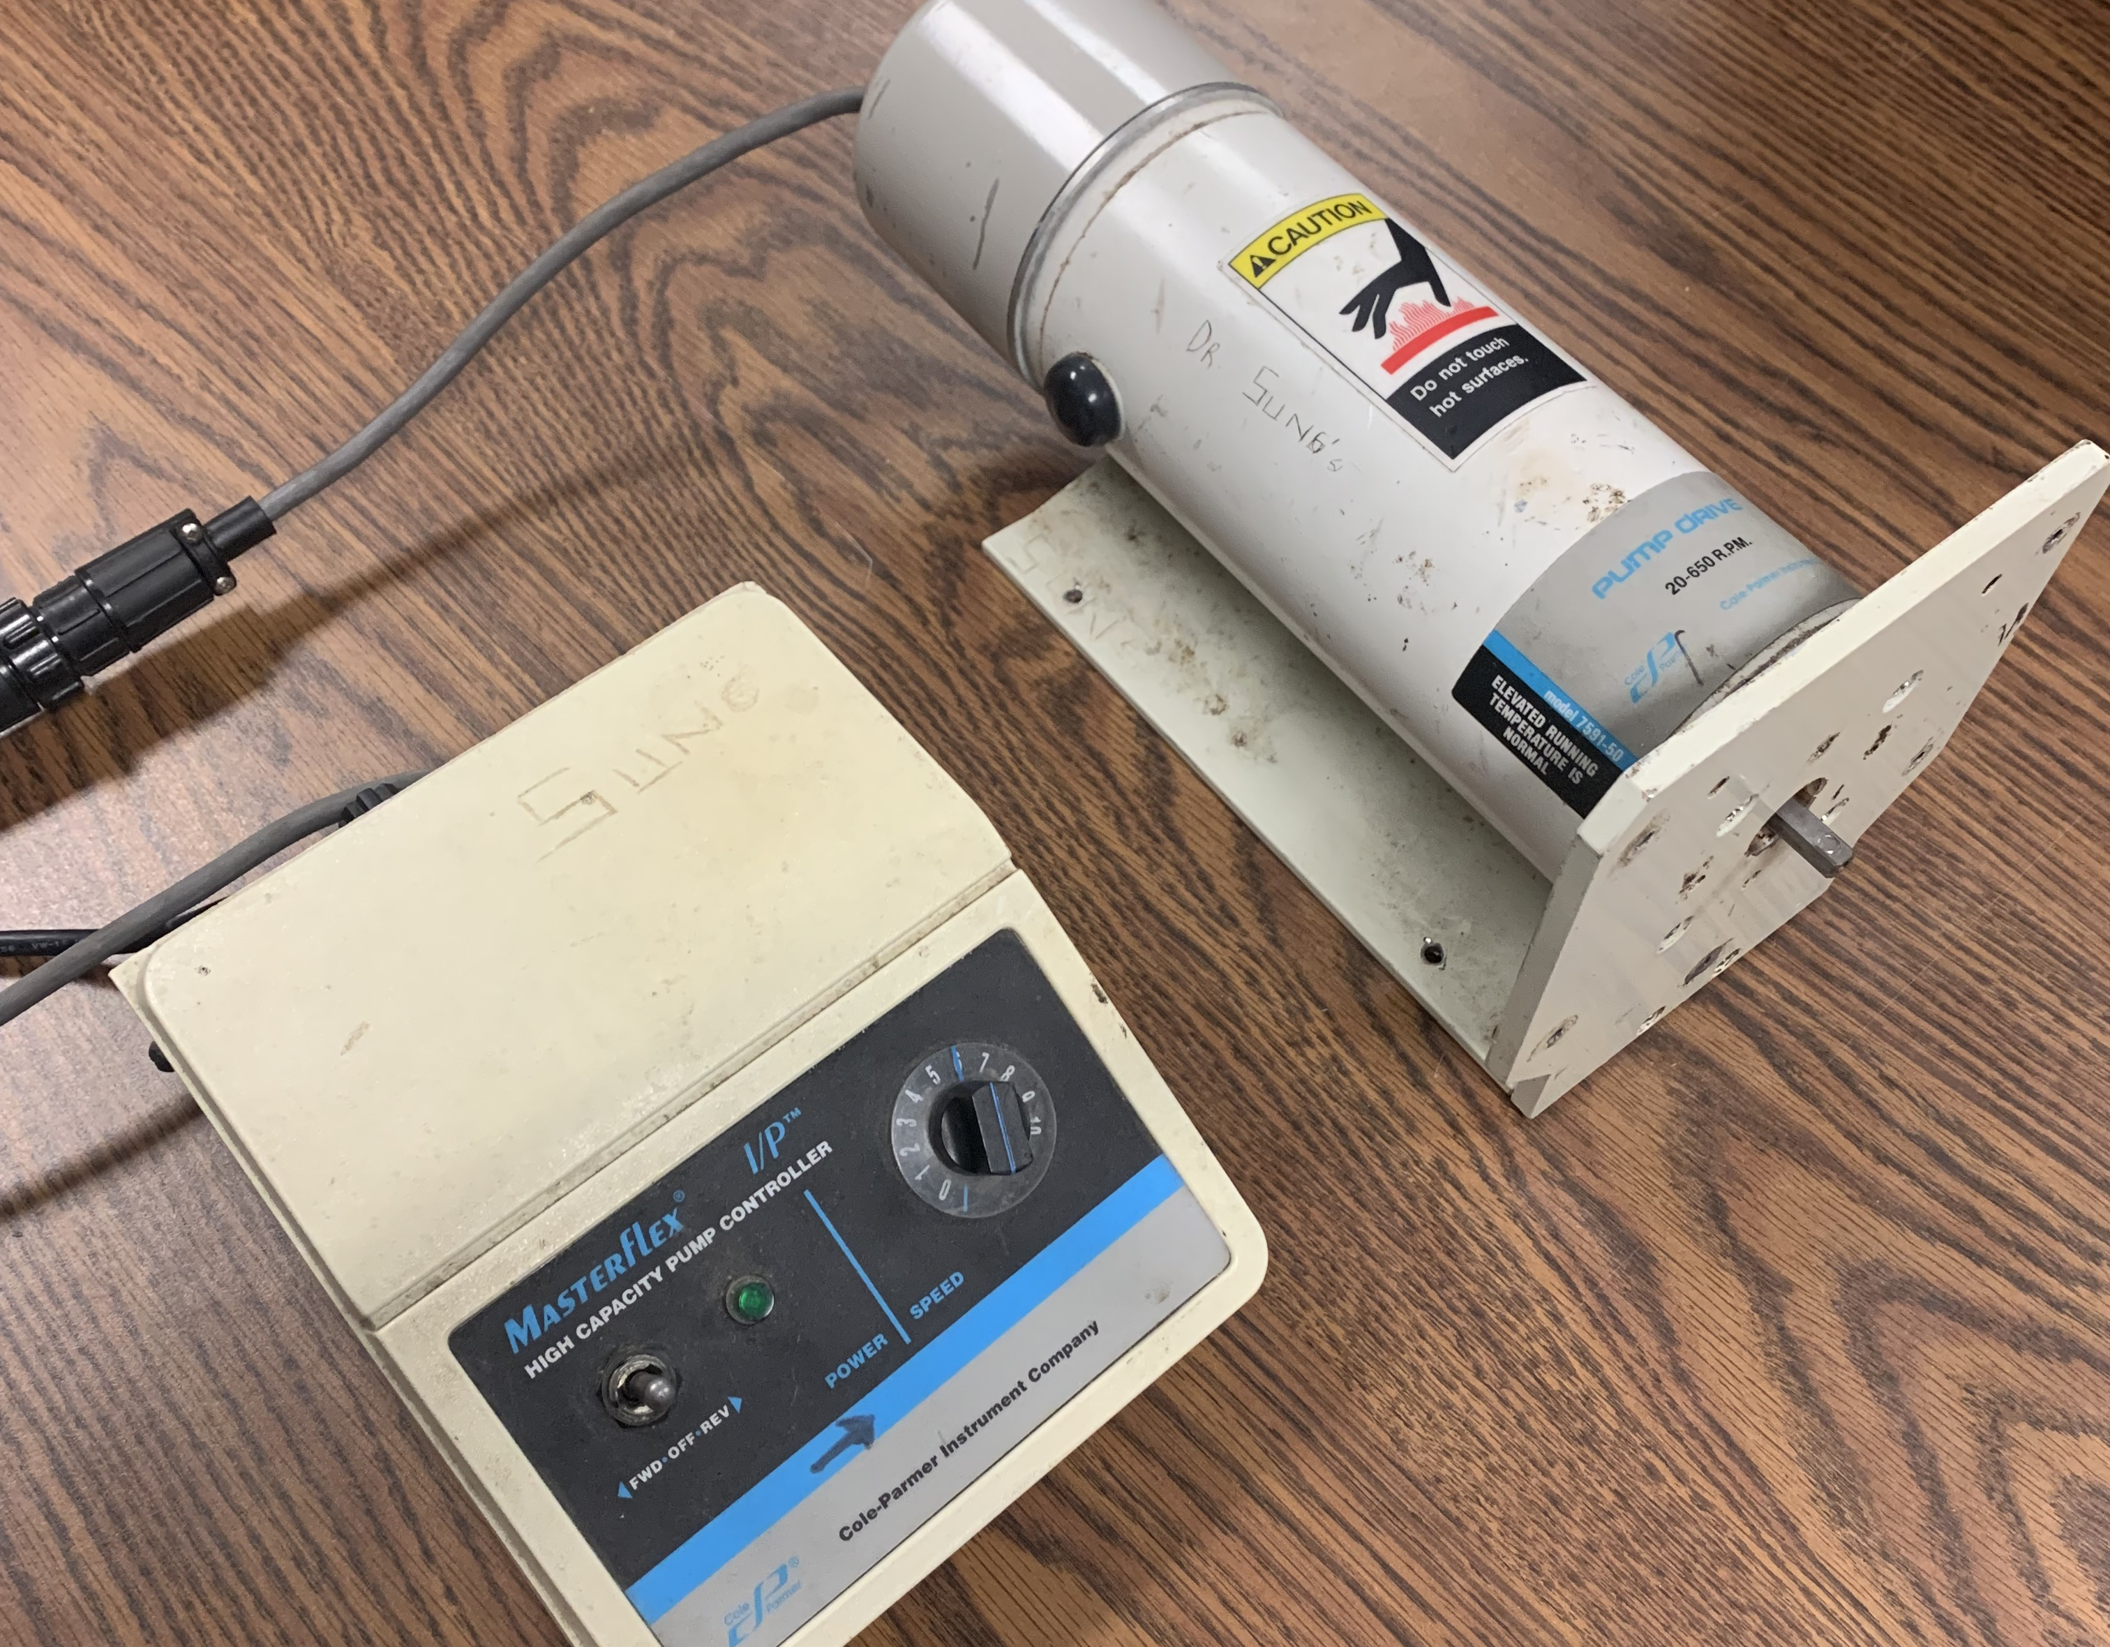
Current motor
$700-$1,000+
Only reaches up to 650 RPM
0.1 HP
115 V
Designed to push fluid through plastic tubing
Not enough information to create good model

Slide 6
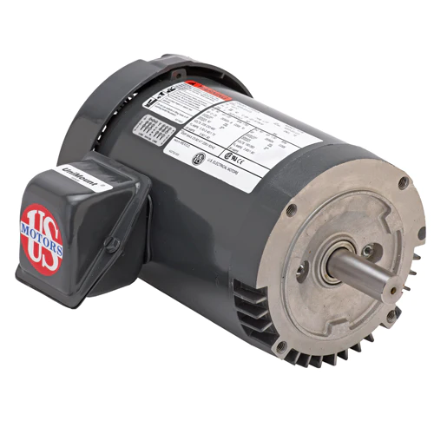
U.S. Motors T13S1ACR,TEFC,3PH,STD
$230.88
0.33 HP
208-230 V
1.7-1.8 A
3450 RPM
Need to purchase controller and transformer

Slide 7
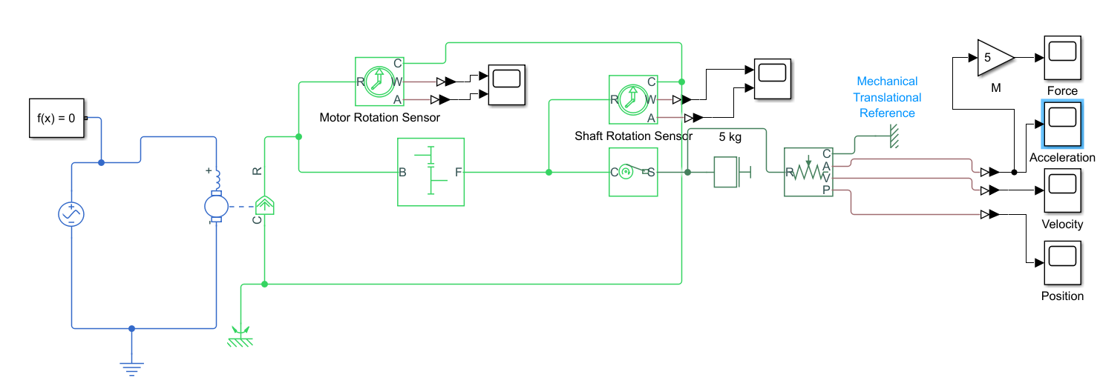
Simulink model

Slide 8
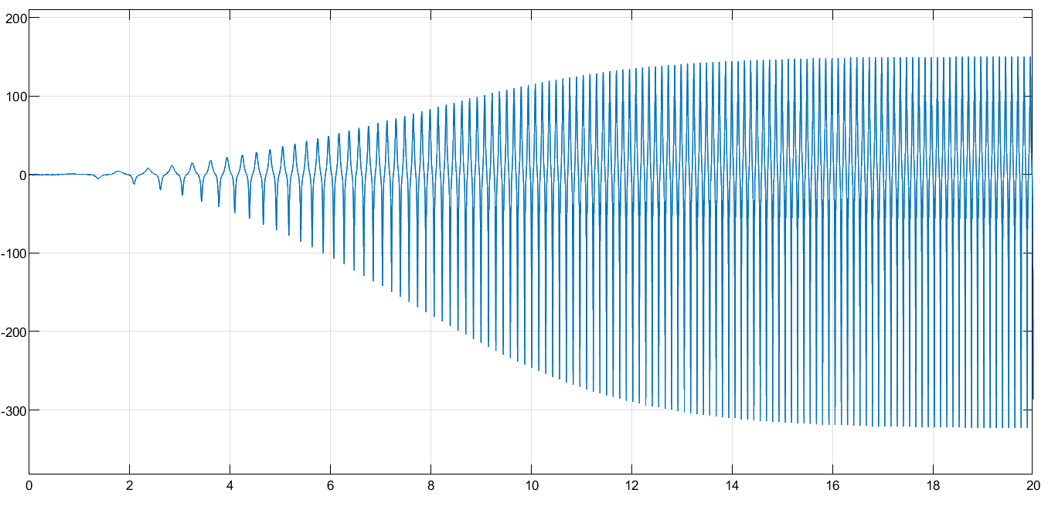
Simulink model (Acceleration) 120 V

Slide 9
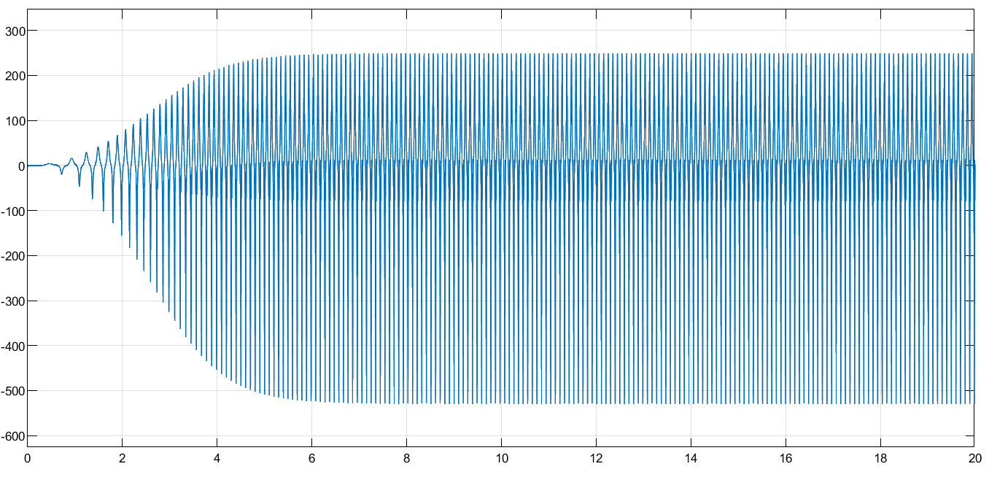
Simulink model 230 V

Slide 10
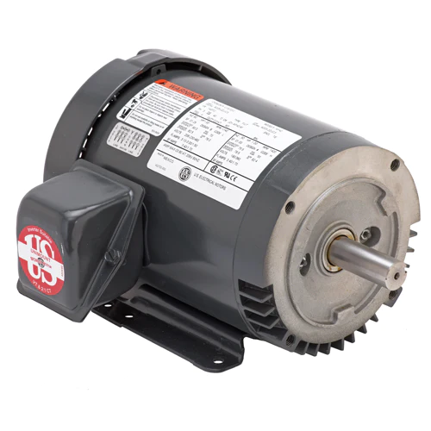
U.S. Motors U34S2AC - 0.75 HP - TEFC - 1750 RPM
$272.25
0.75 HP
208-230 V
2.7 A
1750 RPM
Need to purchase controller and transformer

Slide 11
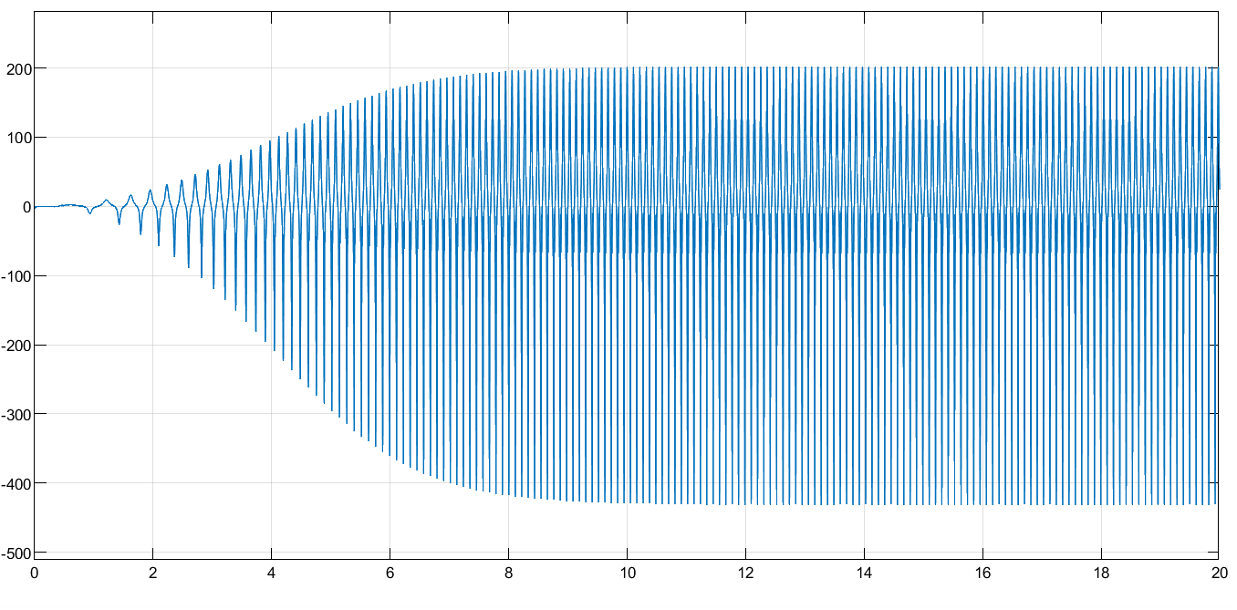
Simulink model 120 V

Slide 12
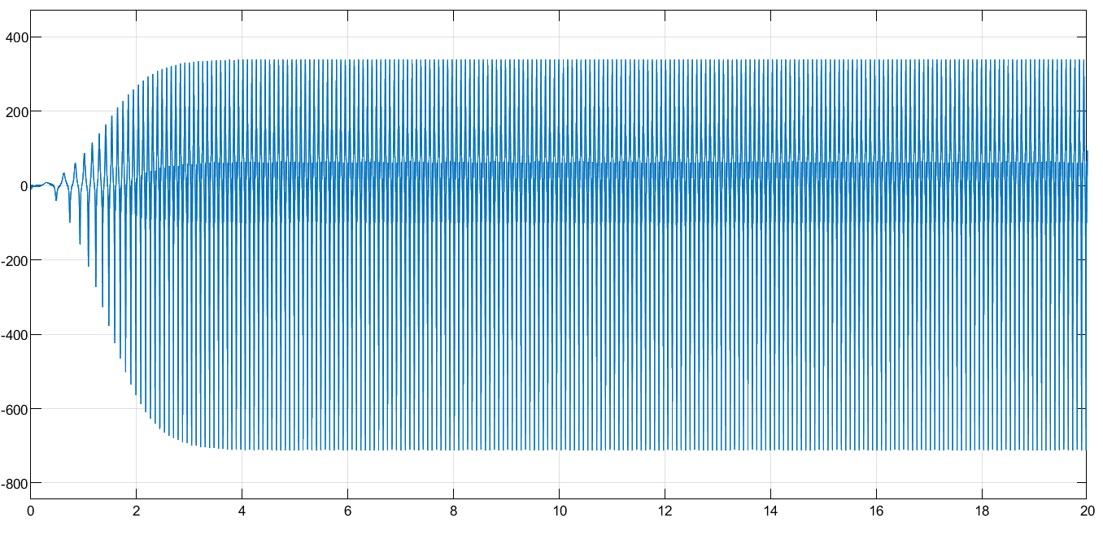
Simulink model 230 V

Slide 13
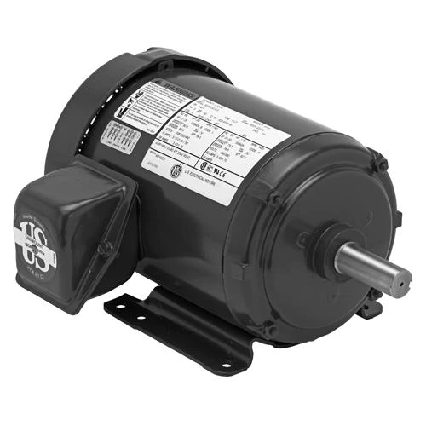
U.S. Motors T14S2A,TEFC,3PH,STD
$185.36
0.25 HP
208-230 V
1.1 A
1725 RPM
Need to purchase controller and transformer

Slide 14
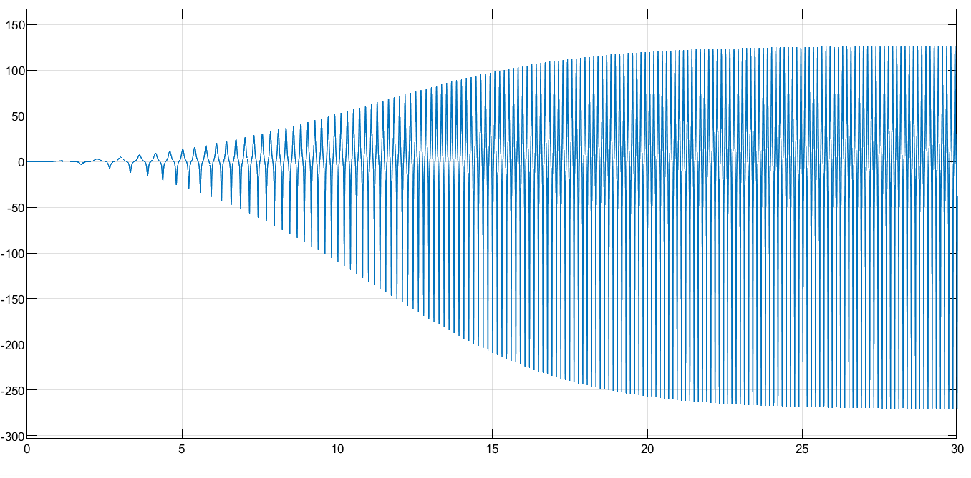
Simulink model 120 V

Slide 15
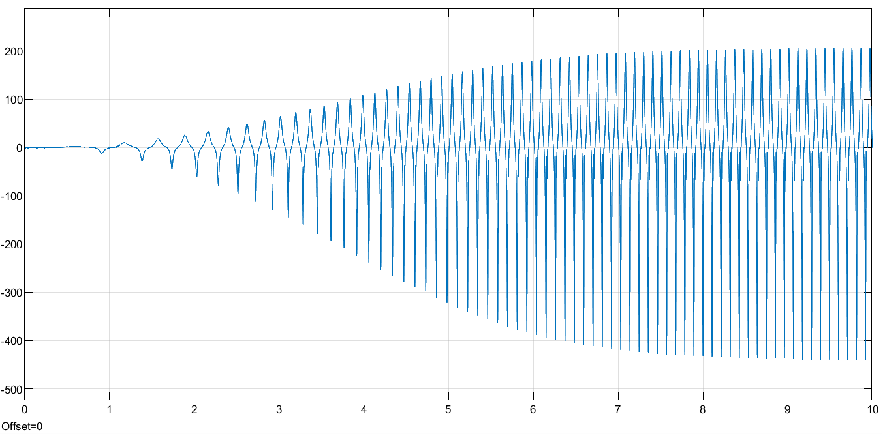
Simulink model 230 V

Slide 16
Thanks!
Name
Title
Email
Social

Slide 17
References
https://pim-resources.coleparmer.com/instruction-manual/manual-for-ew-07521-50.pdf
https://kpaulmotors.com/products/u-s-motors-t13s1acr-tefc-3ph-std?variant=39620103471168&utm_source=google&utm_medium=cpc&utm_campaign=Google+Shopping&currency=USD&gclid=Cj0KCQiAvqGcBhCJARIsAFQ5ke6KL1aLOVLDuMJFiDxfxLAoPL0qDfZ3pRh8jAmZCpkdwMWchaBHlDsaAutOEALw_wcB
https://kpaulmotors.com/products/u-s-motors-u34s2ac-0-75-hp-tefc-1750-rpm?_pos=1&_fid=954ee38cb&_ss=c
https://kpaulmotors.com/products/u-s-motors-t14s2a-tefc-3ph-std?_pos=1&_fid=954ee38cb&_ss=c

